Slide 1
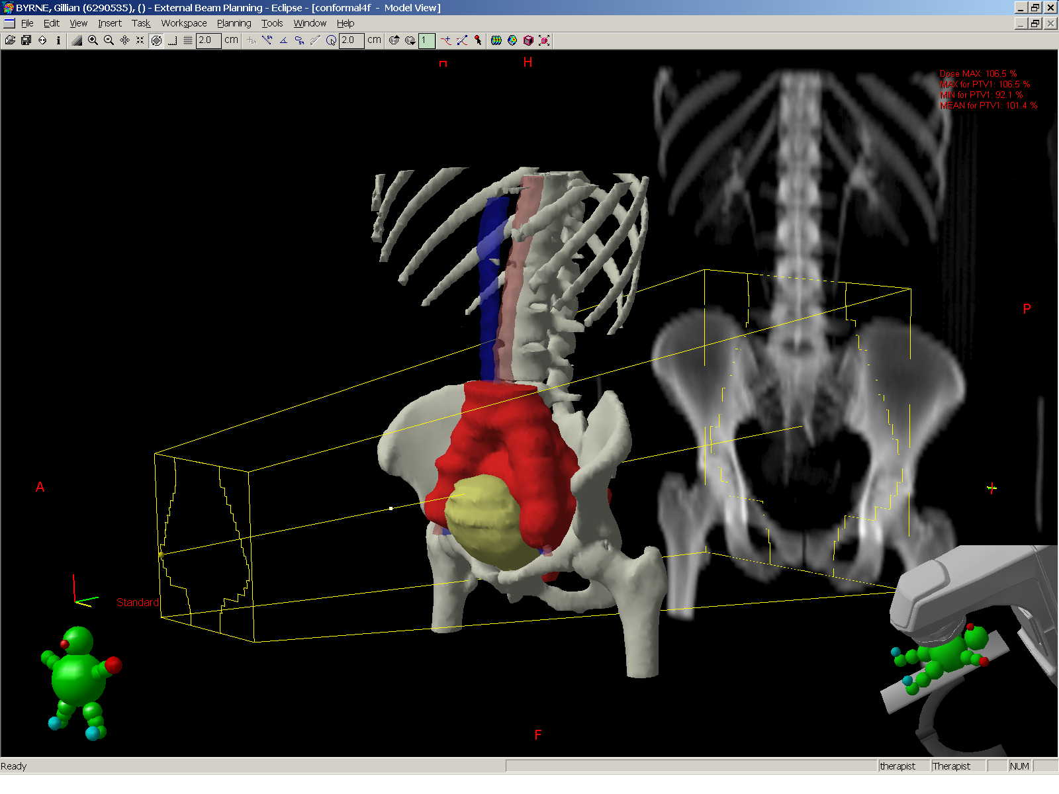
Role of Radiotherapy in Grade 3 FIGO IB Endometrial Cancer
Alexandra Taylor, MBBS, MD
Royal Marsden Hospital
London, United Kingdom
Notes:
1

Slide 2
Adjuvant Treatment Endpoints
Overall Survival
Locoregional control
Prevention of uncontrolled pelvic disease
Prevention of stress and morbidity of diagnosis and treatment of pelvic relapse
Quality of life
Treatment toxicity
Disease
Notes:
2

Slide 3
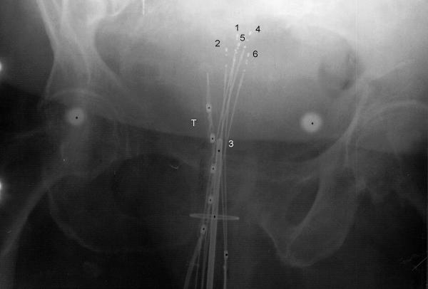
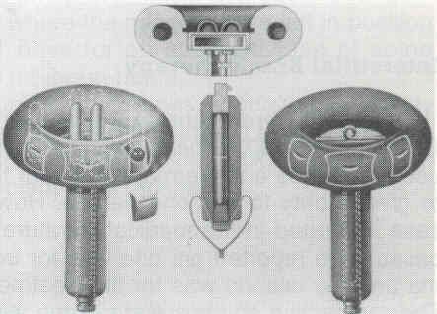
Radiotherapy for Endometrial Cancer Historical Background
1901: First use of radium for intrauterine insertion
Pre-operative radiotherapy became standard
1970s: Move to tailored post-operative radiotherapy based on pathology
Excellent outcomes for stage I disease in retrospective studies with adjuvant RT
Pelvic control >95%
5-year survival 80%-98%
Concerns about over-treatment
Intrauterine applicators
Vaginal applicators 1920
Notes:
Use of RT in early endomterial cancer is controversila, with widespread variaiton in practice. In setting background for use of RT, consider that the standard of care for almost all endometrial cancers throughout most of the last centuryhas been the inclusion of radiotherapy – often pre-operative ICRT and either pre or post-op EBRT. Concerns that this was overtreatment for many cancers, and by the 1980s move to tailored post-op radiotherapy based on the patholoigcal findings.
3

Slide 4
Post-Operative Radiotherapy for Stage I Endometrial Cancer Randomised Trials
Surgery
No RT or VBT *
Pelvic radiotherapy
Norwegian Radium Hospital * n = 540 1968-74
GOG 99 n = 392 1987-95
PORTEC n = 715 1990-97
ASTEC + NCIC EN.5 * n = 905 1996/8-2004
PORTEC 2 * n = 427 2002-06
Sorbe (Swedish) * n = 527 1997-2008
Notes:
We now have evidence from 4 large randomised studies in early stage disease each recruiting over 6-8 years– basic design is surgery followed by pelvic RT or not. Although each study has particular features of design and patinets. Briefly run though the resultsd from these -
4

Slide 5
FIGO Staging 1998 Endometrium
I Confined to corpus uteri
IA Limited to endometrium
IB Invades up to one half of myometrium
IC Invades more than half of myometrium
II Invades cervix
IIA Endocervical glands only
IIB Cervical stromal invasion
IIIA Involves serosa, adnexa +/or +ve peritoneal washings
IIIB Vaginal involvement
IIIC Pelvic +/or para-aortic LNs
IVA Invades bladder or bowel mucosa
IVB Distant metastases

Slide 6
Revised FIGO Staging 2009 Endometrium
I Confined to corpus uteri
IA Invades up to one half of myometrium
IB Invades more than half of myometrium
II Invades cervical stroma
IIIA Involves serosa or adnexae
IIIB Vaginal or parametrial involvement
IIIC 1 Pelvic LN
IIIC2 Para-aortic LN
IVA Invades bladder or bowel mucosa
IVB Distant metastases

Slide 7
Norwegian Radium Hospital Trial Aalders et al, Obs Gyn 1980
Clinical Stage I
N = 540
TAH+BSO
NO lymph node
dissection
Pelvic RT
40 Gy / 20#
Vaginal brachytherapy
60 Gy to surface
No further therapy
9-year outcomes No EBRT EBRT
Overall survival 90% 87%
Local recurrence (all) 7% 2%
Local recurrence (G3 IC) 20% 5%
Distant metastases 5% 10%
Aalders J, et al. Obstet Gynecol. 1980;56(4):419-427.
Notes:
The first study reported in 1980 from the Norwegian Radium Hsopital. Clinical stage one disease, simple hyst, NO LND. All patients received post-op vaginal brachytherapy – so this study really looked at ICRT vs EBRT. No difference in survial - , but sig reduction in local recurrence, and no impact on devt of distant disease.
7

Slide 8
PORTEC Trial Creutzberg et al, Lancet 2000
G2-3 IB, G1-2 IC
N = 715
TAH+BSO
NO lymph node
dissection
Pelvic RT
46 Gy / 23#
No brachytherapy
No further therapy
No EBRT EBRT
5-yr overall survival 84% 80%
5-yr local recurrence 14% 4%
Toxicity: All grades 4% 26%
Creutzberg CL, et al. Lancet. 2000;355(9213):1404-1411.
Notes:
Similar study aimed at intermideoate risk - excluded G£ IC as felt should have EBRT, but did include all histologies. No lymph node dissection. No differnece in survival, but even more benfit for LR 14% reduced to 4%. Central pathology review, and grade reclassifed for a hgih percentyage so many G2 were G1 and excluded ineliglbe pts. Similar no survial benfit – but trend actually to the no EBRT arm but LR benfit maintained.
8

Slide 9
GOG 99 Keys et al, Gyn Onc 2004
IB – II (occult)
N = 392
TAH + BSO
Pelvic + PA lymph node
dissection
Pelvic RT
50.4 Gy / 28#
No brachytherapy
No further therapy
No EBRT EBRT
4-yr overall survival 86% 92% P = .57
4-yr local recurrence 9% 1%
Toxicity: lymphoedema 3% 5%
severe GI 1% 7%
Keys HM, et al. Gynecol Oncol. 2004;92(3):744-751.
Notes:
GOG 99 study reported in 2004. Eligibility cirteri was endometrioid only, IB-II high risk early stage– patients had lymph node dissection – pelvic and PAN, although sampling or systematic njot specifically required. Reandomised EBRT vs nil - no brachy used. No sig diff in OS, but reduction in local recurrence from 9% to 1%.
9

Slide 10
High Risk Factors - Subset Analysis
GOG 99
PORTEC
High risk factors
G2, 3 – Age
LVSI
Deep myometrial invasion
High intermediate risk group
>70 yrs and 1 factor
50-70 yrs and 2 factors
<50 yrs and 3 factors
HIR 2-yr locoregional relapse: 26% vs 6%
High risk factors
>60 yrs
G3
Deep myometrial invasion
2 factors
10 yr LRR 23% vs 5%
Using GOG 99 criteria for HIR
10 yr LRR 22% vs 8%
Notes:
In both studies, assessment was made of factors to predict for recurrence – GOG 99 identifed HIR and LIR groups – with approx 1/3 in HIR group. 70 yearsand one facor of high grade, LVSI or IC disese, 50 and 2 factors and less than 50 and 3 factors. HIR gp risk of LRR 26% without RT, and reduced to 6% with RT. Similarly PORTEC group identifed age more than 60, G3 abd IC as risk factors, and having 2 makes risk 23%. They also applied the GOG99 criteria for HIR group with similar esults with risk of recurrnece of 22% cf 7.5%.
10

Slide 11
Sites of Relapse GOG-99 and PORTEC-1
Vaginal
Pelvic
Distant

Slide 12
PORTEC 2 Study Nout et al, Lancet 2010
HIR patients
N = 427
TAH + BSO
NO lymph node
dissection
Pelvic RT
46 Gy / 23#
No brachytherapy
Vaginal Brachytherapy 21 Gy / 3# HDR
30 Gy / 1# LDR
EBRT VBT
3-yr overall survival 84% 84% P = .55
3-yr disease-specific survival 89% 89% P = .38
Nout RA, et al. Lancet. 2010;375(9717):816-823.
Notes:
Age>60, IC G1-2 or IB G3, Stage 2A grade 1-2
12

Slide 13
ASTEC Trial and NCIC EN5 Trial ASTEC/EN.5 Study Group, Blake et al, Lancet 2009
G2 IC, G3 IA-C, IIA
Serous, clear cell
N = 905
TAH + BSO
+/- Lymph node
Dissection (29%)
Pelvic RT
45 Gy / 25#
Brachytherapy as per centre policy (52%)
No EBRT
Brachytherapy as per centre policy (51%)
No EBRT EBRT
5-yr overall survival 84% 84%
5-yr disease-specific survival 89% 89%
ASTEC/EN.5 Study Group, et al. Lancet. 2009;373(9658):137-146.
Notes:
EN5 started 1996. Modified to allow joint analysis with ASTEC from 1998. Entry criteria same escept IIA pap serous allowed in ASTEC.
Lymph node dissection – ASTEC as part of the surgical arm – LN positive allowed, EN5 not allowed. Overall survival primary endpoint 10% difference 75% to 85%
13

Slide 14
Randomised Trials: Conclusions
RT improves local control, particularly in subset with high-risk features
No impact on overall survival
High salvage rate for recurrences
Increases toxicity

Slide 15
Radiotherapy has no effect on survival?

Slide 16
SEER Registry
Proportion of diagnosed uterine cancers
Proportion of deaths from uterine cancer
Notes:
SEER registry
4180 unfavourable histology
1473 UPSC
391 CC
2316 G3
16

Slide 17
GOG 33: Surgicopathologic Risk Factors Incidence of Pelvic Lymph Nodes
Depth of myometrial invasion
G1
G2
G3
None
0%
3%
0%
Inner 1/3
3%
5%
11%
Middle 1/3
0%
9%
4%
Outer 1/3
11%
19%
34%
Creasman WT, et al. Cancer. 1987;60(8 Suppl):2035-2041.

Slide 18
Risk Groups in Endometrial Cancer
Low Risk
Stage 1A, G1-2
Intermediate Risk
Stage IB G1-2; Stage IA G3
High risk
Stage IB G3; Stage II
Stage III or IV
Serous or clear cell carcinoma
Carcinosarcoma
No RT
ICRT
?EBRT

Slide 19
G3 IC Outcomes Compared to Stage I PORTEC Trial Creutzberg et al, JCO 2004
99 patients with G3 IC disease
Received adjuvant pelvic RT
G3 IC PORTEC
Locoregional recurrence 14% 3%
Distant metastases 31% 8%
Overall survival 58% G1-2 85%
G3 IB 74%
Creutzberg CL, et al. J Clin Oncol. 2004;22(7):1234-1241.

Slide 20
Radiotherapy for Stage One Disease: SEER Database Lee et al, J Clin Oncol 2006
n = 21,249 19% received RT
G3 IC
886 patients: 66% received RT
Hazard ratio for survival
All patients 0.72 (0.57-0.92)
LND 0.73 (0.55-0.96)
Lee CM, et al. J AMA. 2006;295(4):389-397.

Slide 21
Can Pelvic RT Improve Survival?
No RT RT
FIGO report, 2006
IC disease 5YS 75% 86%
Norwegian Radium Hospital Trial
G3 IC 9YS 72% 82%
GOG 99
HIR 4YS 74% 88%
ASTEC
High risk No difference

Slide 22
Radiotherapy causes unacceptable toxicity?

Slide 23
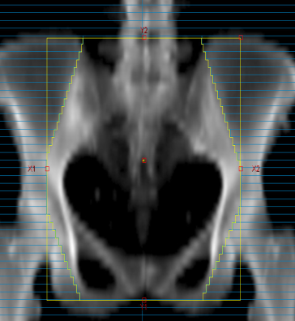
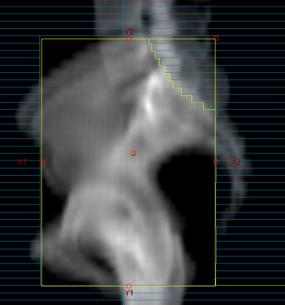
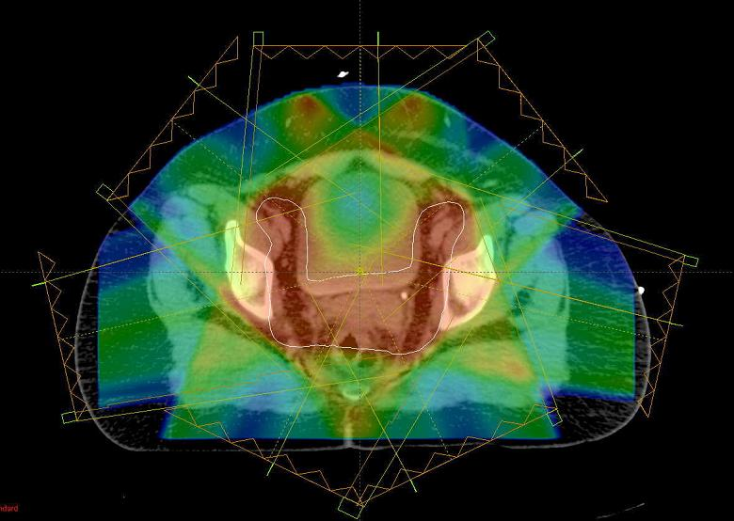
External Beam Radiotherapy
Target volume:
Pelvic lymph nodes, parametrium, and upper vagina
Conventional RT:
2D planning
Toxicity: G1+ 20%-30%, G2+ 9%
Intensity-modulated radiotherapy:
Reduces dose to bowel, bladder, and rectum by 40%-60%
Chen LA, et al. Gynecol Oncol. 2015 Jan 3. [Epub ahead of print].
3-yr late toxicity 16% vs 45%
Notes:
23

Slide 24
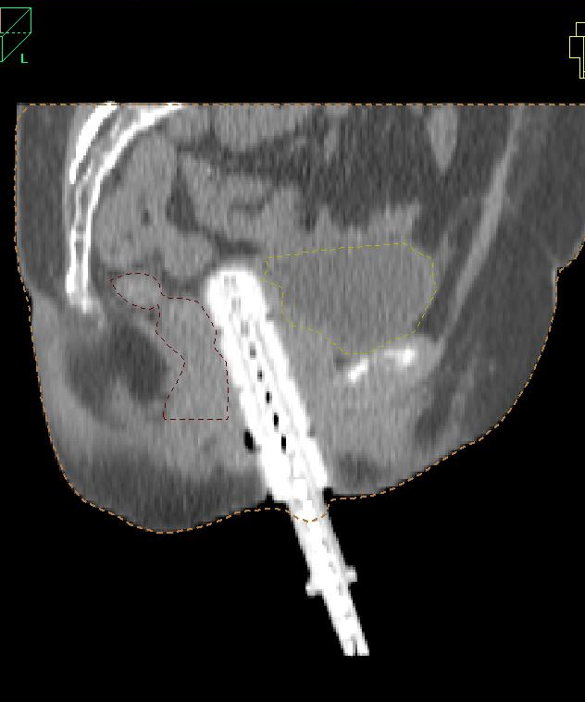
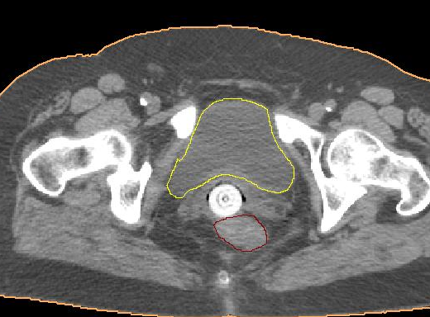
Vaginal Vault Brachytherapy (VBT)
Target volume
Vaginal vault only
Late toxicity
G3 0%
QoL studies: impact on sexual function
Notes:
Add in about negative lymph node dissection - series with node negative and excellent control. But point out GOG 99 with LND dissection – addiitonal benfit for both pelvic – 4% pelvic.
24

Slide 25
Vaginal Vault Brachytherapy Alone After Negative Lymphadenectomy
Straughan, Gynecol Onceol 2004
No RT RT
(n = 121) (EBRT n = 33 / VBT n = 56)
Local relapse 7% 1%
3-yr DFS 71% 93%
3-yr OS 90% 92%
In several series with G3 or IC disease, overall pelvic relapse 4% (14/381)
Notes:
Retrospective studies: excellent control. 4% recurrence
In keeping with recurrence in GOG 99 – 4%
25

Slide 26
Long-Term Risk of Second Cancer After Radiotherapy Witlink et al, JCO 2014
Pooled data from 3 trials:
Rectal cancer TME trial (n = 1530) EBRT vs No RT
PORTEC-1 (n = 714) EBRT vs No RT
PORTEC-2 (n = 427) EBRT vs VBT
Total: 2554 patients
No difference in incidence between RT and no RT
All survivors higher risk of second cancer compared to general population
HR 2.98 (2.82-3.14)
 | No RT | EBRT | VBT
10 years | 16% | 15% | 15%
15 years | 26% | 26% | -
Witlink LM, et al. J Clin Oncol. 2014 Dec 22. [Epub ahead of print].

Slide 27
Adjuvant radiotherapy or treatment upon relapse?

Slide 28
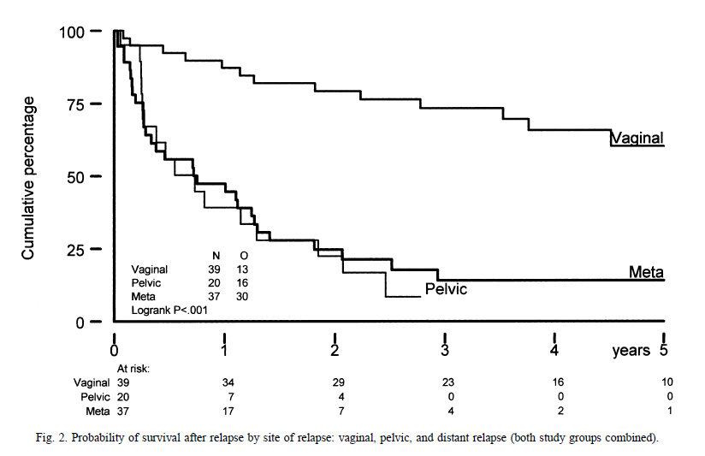
Vaginal Recurrence of Endometrial Cancer
Multiple case series
Complete response: up to 95%
Local control
Confined to mucosa 80%-90%
More advanced disease 60%-70%
Sidewall relapse 15%-30%
5-yr overall survival 25%-68%
Creutzberg CL, et al. Gynecol Oncol. 2003:80(2);201-209.
Notes:
28

Slide 29
IMRT With Image Guided Brachytherapy for Vaginal Recurrence of Endometrial Cancer Vargo et al, Radiother Oncol 2014
41 patients
EBRT with IMRT
Image guided HDR brachytherapy
CR 95%
3 yr LC 95%
3 yr RFS 68%
3 yr OS 67%
Late Toxicity: G3+ 8% (2 patients)
Vargo JA, et al. Radiother Oncol. 2014;113(1):126-131.
Notes:
29

Slide 30
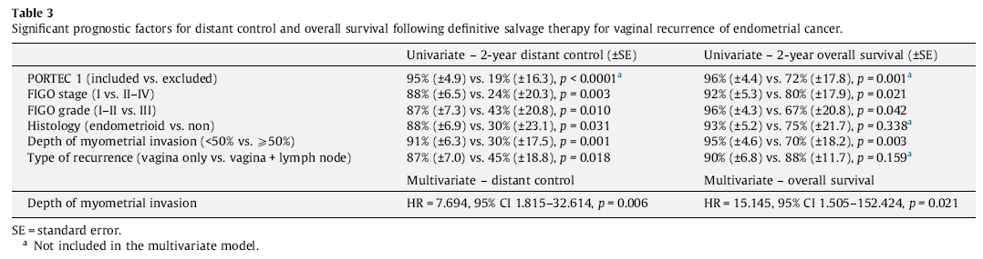
IMRT With Image-Guided Brachytherapy for Vaginal Recurrence of Endometrial Cancer Interplay of PORTEC Risk Stratification Vargo et al, Radiother Oncol 2014
Vargo JA, et al. Radiother Oncol. 2014;113(1):126-131.
Notes:
30

Slide 31
With the high risk of distant spread, is there any benefit in local therapy?

Slide 32
Potential Models of Spread
Early dissemination of disease
Lymph node involvement prognostic
Improved locoregional control may prevent local complications, but unlikely to improve survival
Requires effective systemic therapy
Pathway One
Notes:
32

Slide 33
Models of Spread
Early nodal involvement
Sequential spread
Remains locoregional, so can still potentially cure distant nodal disease
Improvement in local control does impact on survival
Pathway Two
Notes:
33

Slide 34
Node-Positive Disease Klopp et al, Gyn Onc 2009
68 patients: 50 received RT and 18 no RT (+chemo/hormones)
61% pelvic node positive, 39% PAN positive
RT No RT
Pelvic control 98% 61%
DSS 78% 39%
OS 73% 40%
Klopp AH, et al. Gynecol Oncol. 2009;115(1):6-11.

Slide 35
Node-Positive Disease Secord et al, Gynecol Oncol 2013
265 optimally resected stage IIIC
RT Chemo Chemo+RT
RFS 73% 56% 73%
OS 95% 78% 90%
P = .0005
Secord AA, et al. Gynecol Oncol. 2013;128(1):65-70.

Slide 36
Can Chemotherapy Replace Radiotherapy? Mundt et al, IJROBP 2001
43 high risk patients
4-6 cycles of chemotherapy
67% relapsed:
40% pelvis
56% extra-pelvis
31% first site of relapse in pelvis
20% only ever pelvic disease
NO
Mundt AJ, et al. Int J Radiat Oncol Biol Phys. 2001;50(5):1145-1153.

Slide 37
Chemotherapy and Radiotherapy?
Need to determine optimal schedule
NSGO-EORTC/MaNGO EBRT vs EBRT+CT
PORTEC-3 EBRT vs Chemo-RT + CT
GOG 0249 EBRT vs VBT + CT

Slide 38
Conclusions Radiotherapy for G3 IB disease
Risk of local relapse 30%-40%
Risk of distant relapse 30%-40%
Recommendation
No / limited LND or extensive LVSI EBRT
LND – node negative VBT
Consider chemotherapy

